Slide 1
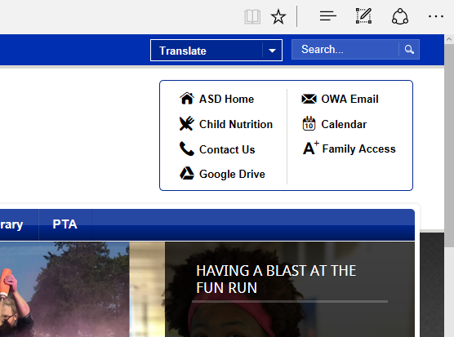
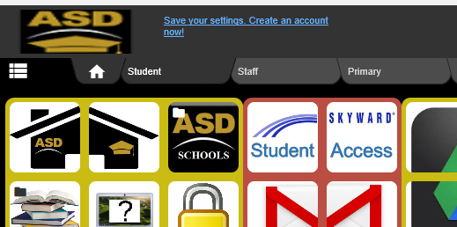
How to check your grades, missing assignments and more!
You can get to your “Skyward Student Access Account”easily using these options.
Our school website
Symbaloo

Slide 2
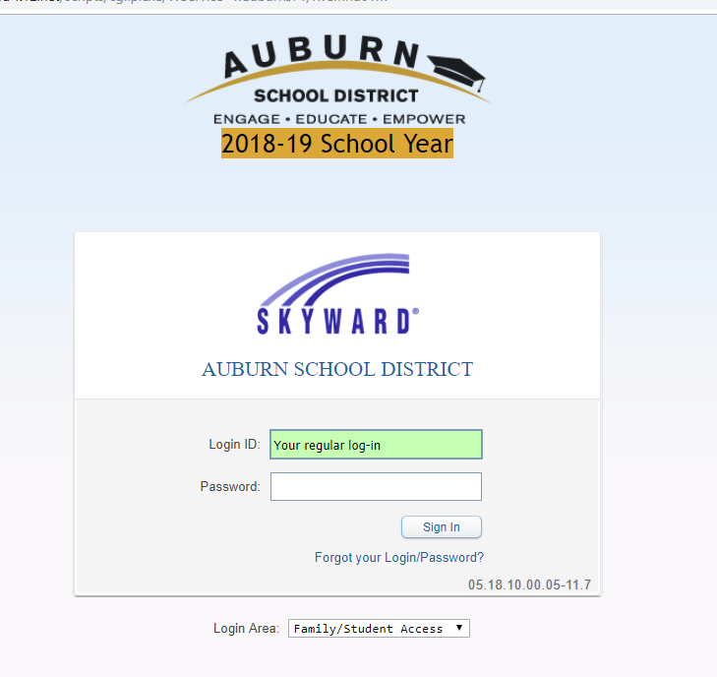
Here’s where you log in
Your login ID is the same as you use to log onto your Chromebook or a school desktop computer.
First five letters of your last name
+
First three letters of your first name
+
(usually) 000 No spaces in between
_____________________________________
Password:
If you’ve never visited Skyward before it is:
Two digits for the month of birth
+
Two digits for day of birth
+
Four digits for year of birth
Or, a password you’ve already set up

Slide 3
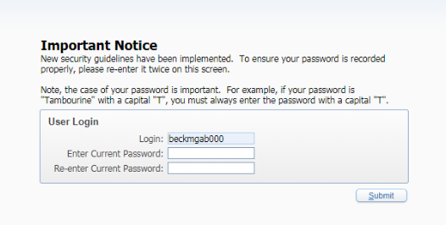
*For added security, you may need to re-enter your password twice.
*Passwords are case sensitive (capital letters and lower case letters must be exact)
*Or if your current password does not meet the requirements, you may be asked to change it.

Slide 4
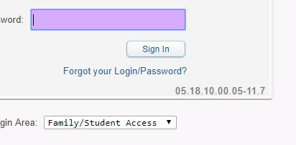
If you forgot your login or password, click here

Slide 5
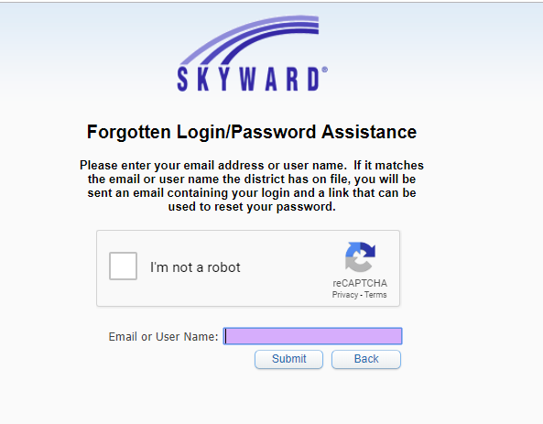
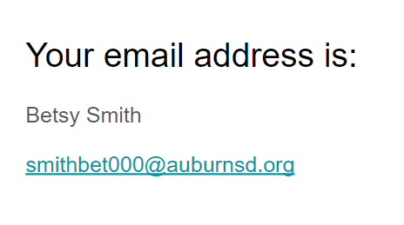
(Regular login+) Your email ends in @auburnsd.org
Click here

Slide 6
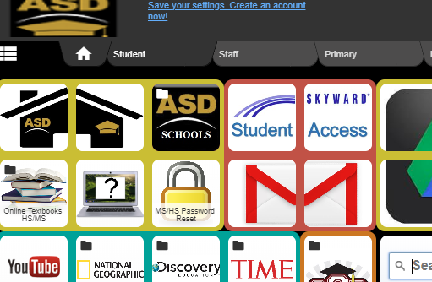
From Symbaloo YOU can check your gmail
Your gmail password is the same password as your login password for your Chromebook.
Click here to access your school email account

Slide 7
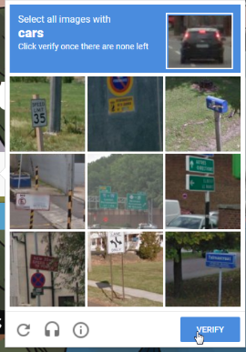
*You may be asked to do a “Captcha”
*This is easy, just identify what you see in the screen pictures. This one is simple; it asks you to click on the images that have *cars* in them.
*If you make an error the first time, you can just try again!

Slide 8
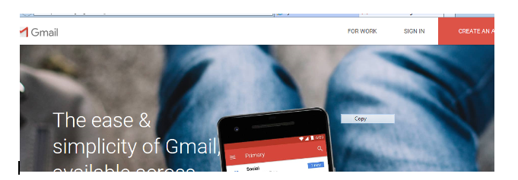
Click on the words “SIGN IN”
You won’t see this screen if you’ve previously signed on

Slide 9
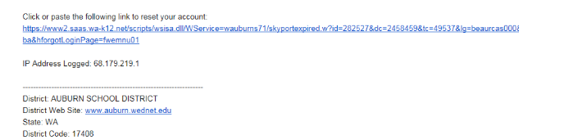
When you’ve ask to change your password - You will receive an email that has the content looking like this:

Slide 10
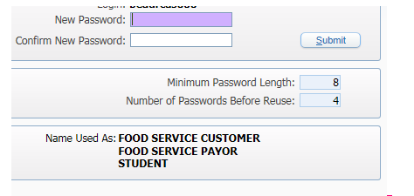
The new password you choose must have at least 8 characters (number of letters or numbers typed)
You must type the same password twice
(BTW: It can’t be one that you’ve already used recently)

Slide 11
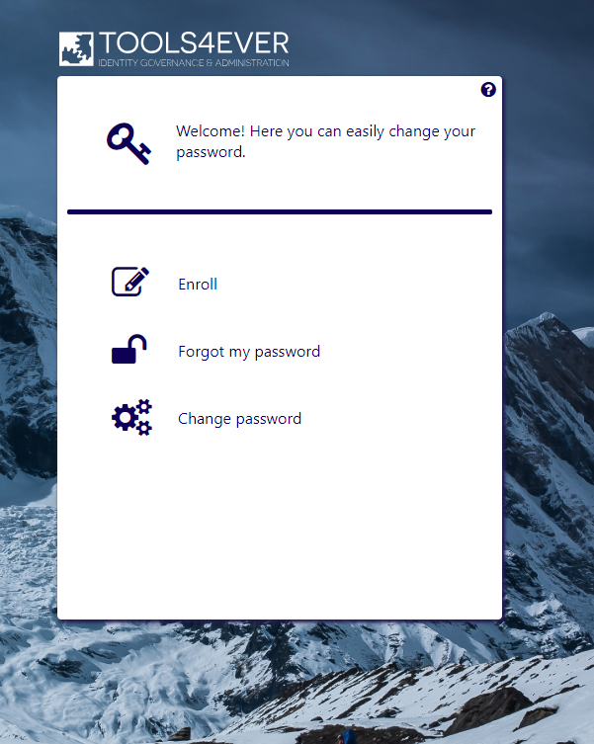
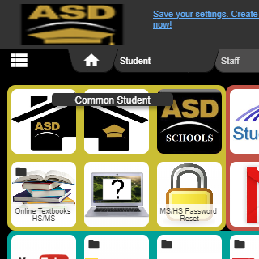
Need to reset your password?
Here’s where it takes you:
From:
Symblaoo

Slide 12
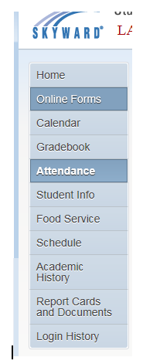
“If you miss school, you miss out!”
Your attendance at school is very important.
Make certain you check your attendance records in Skyward and address any UNEXCUSED absences with your parent/guardian.
If you are absent have your parent/guardian call, email or send a handwritten note to Mrs. Sanseri in the Attendance Office to get your absence excused.

Slide 13
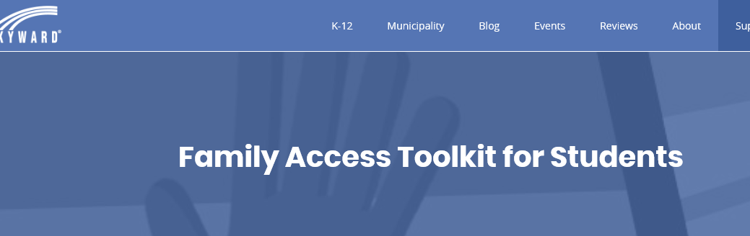
Skyward Video - “Power-up: Grades”
More Power-up videos - Career Plans, Check Your Calendar, E-mail alerts and Push Notifications
TEACHERS: check out these additional links if you want to showcase to students the best usage of Skyward for their the full advantage.

